Slide 1

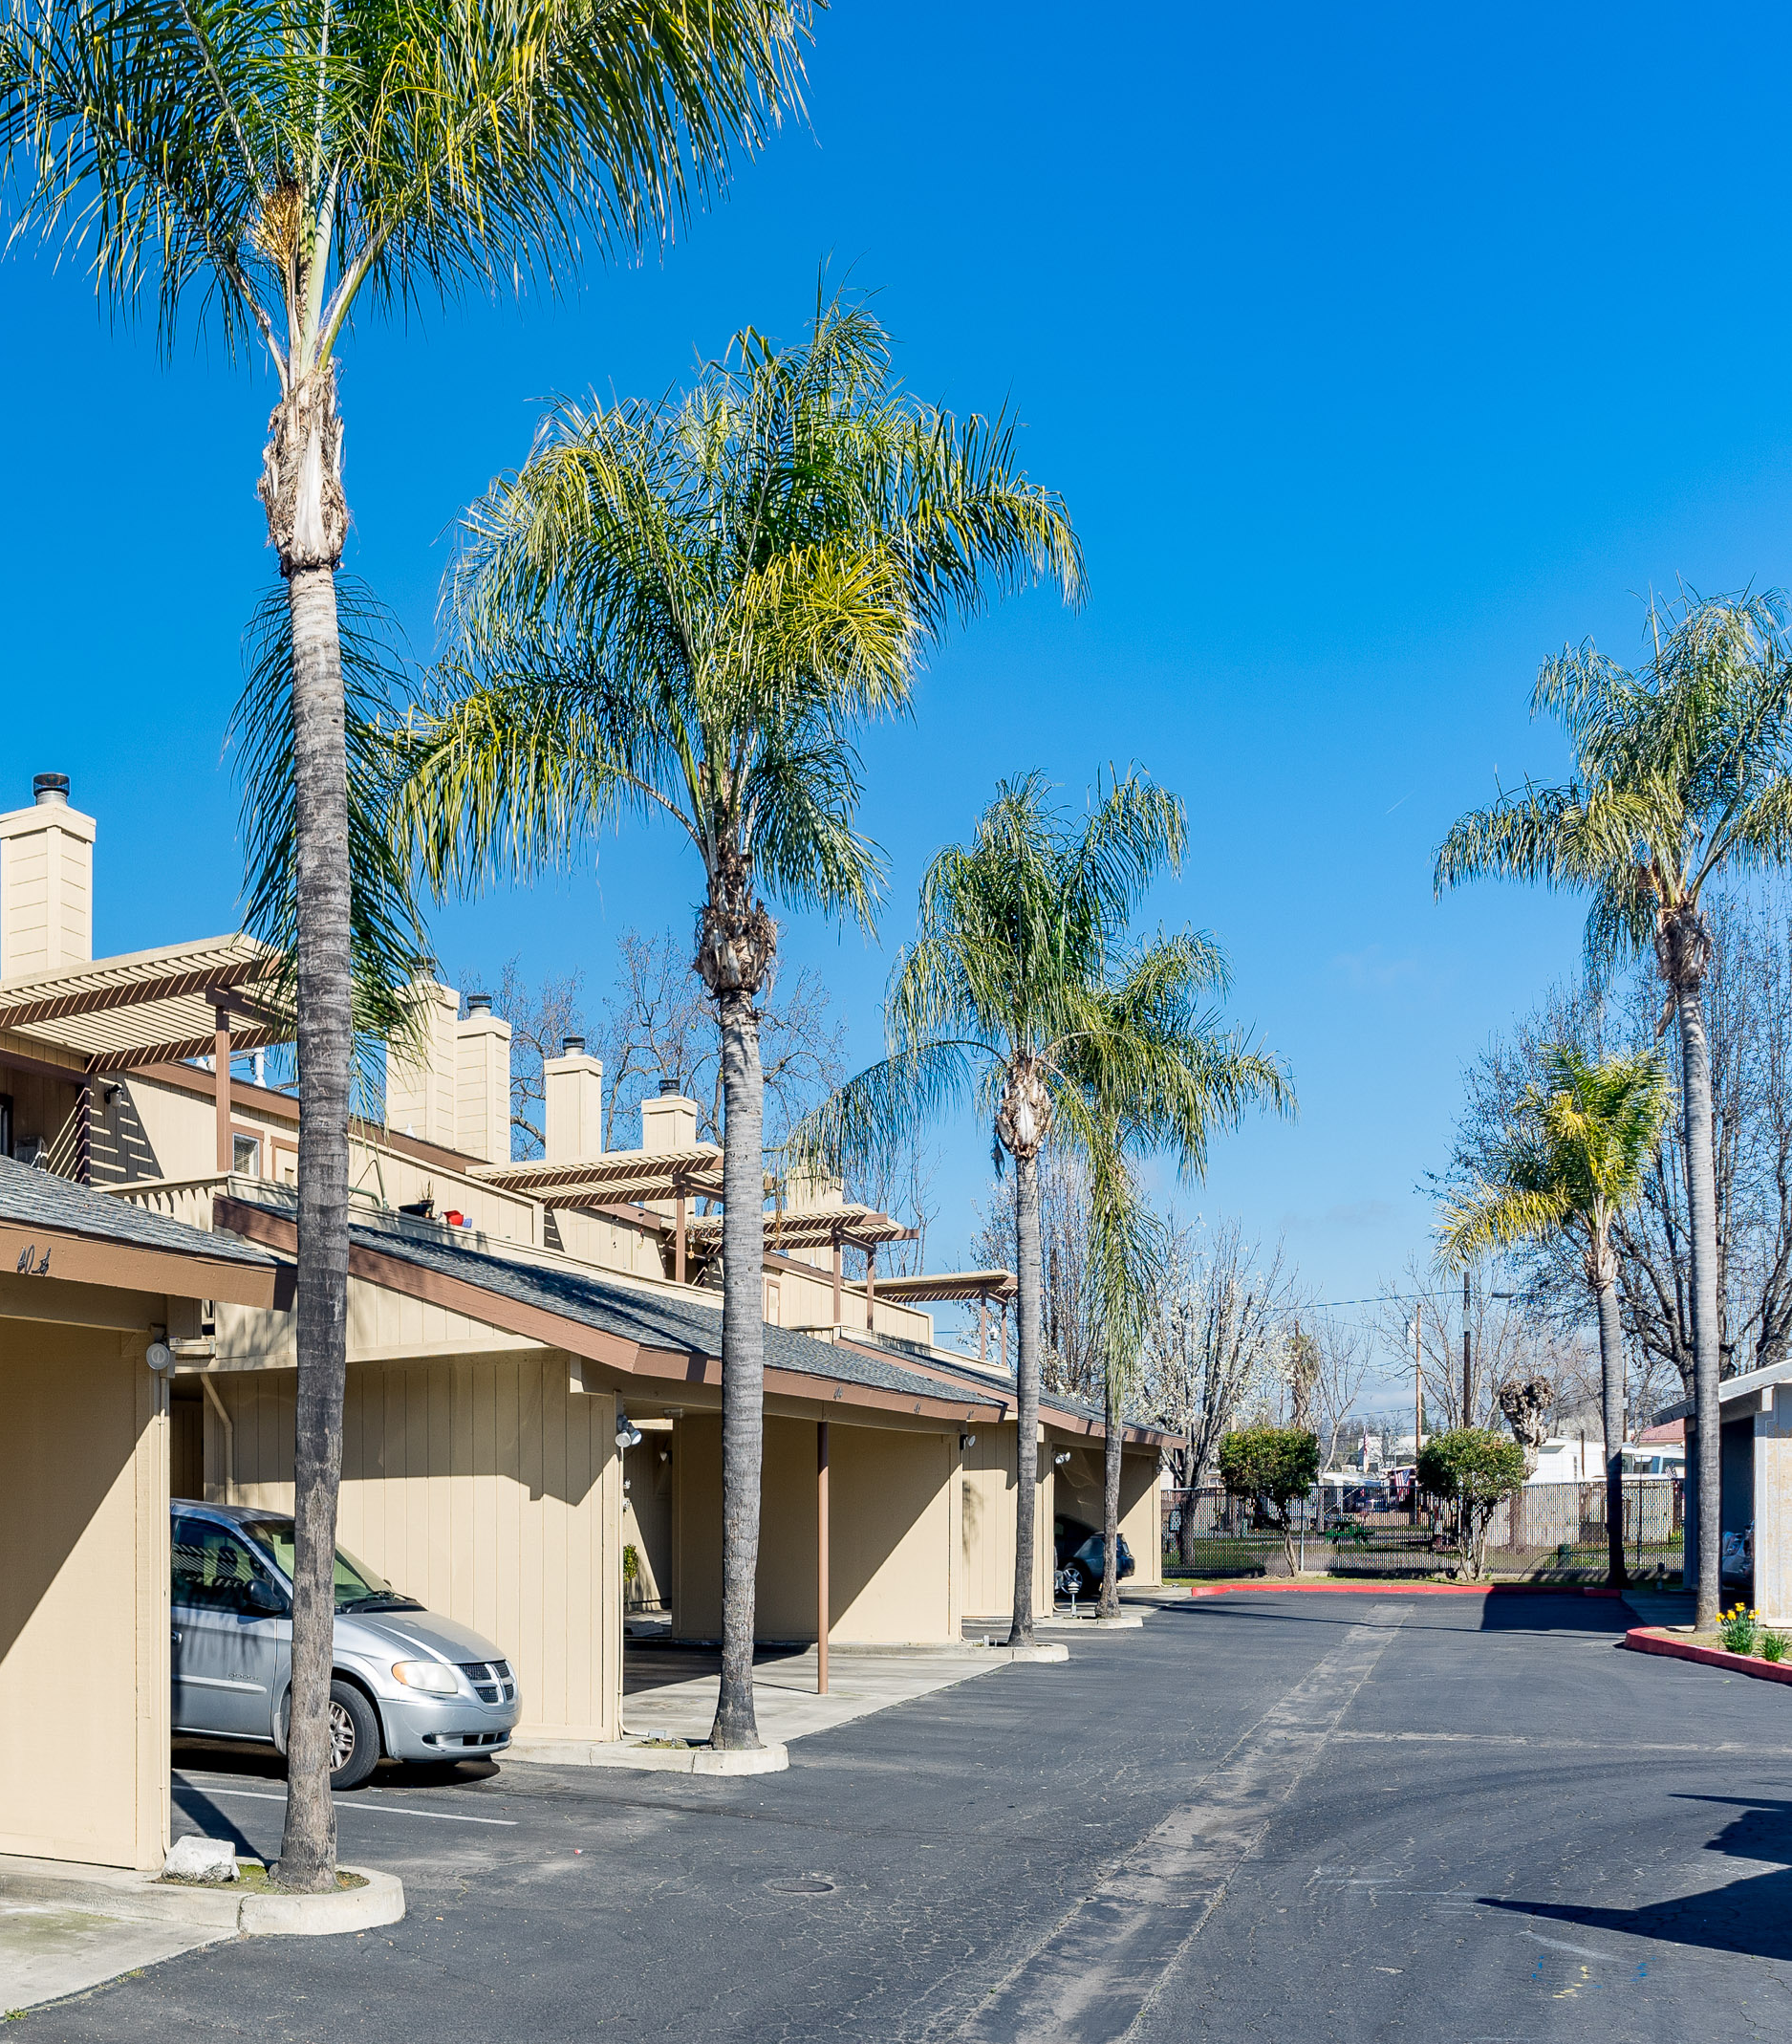
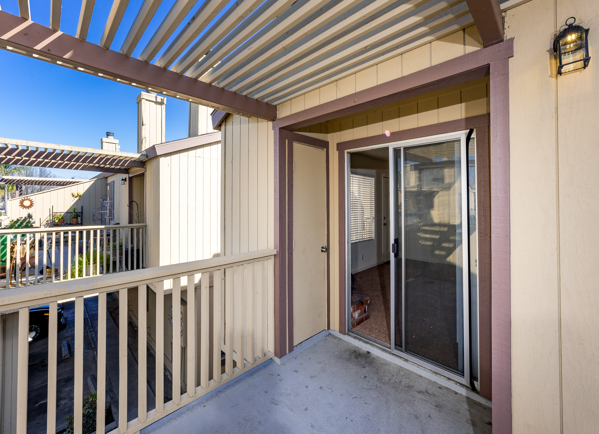
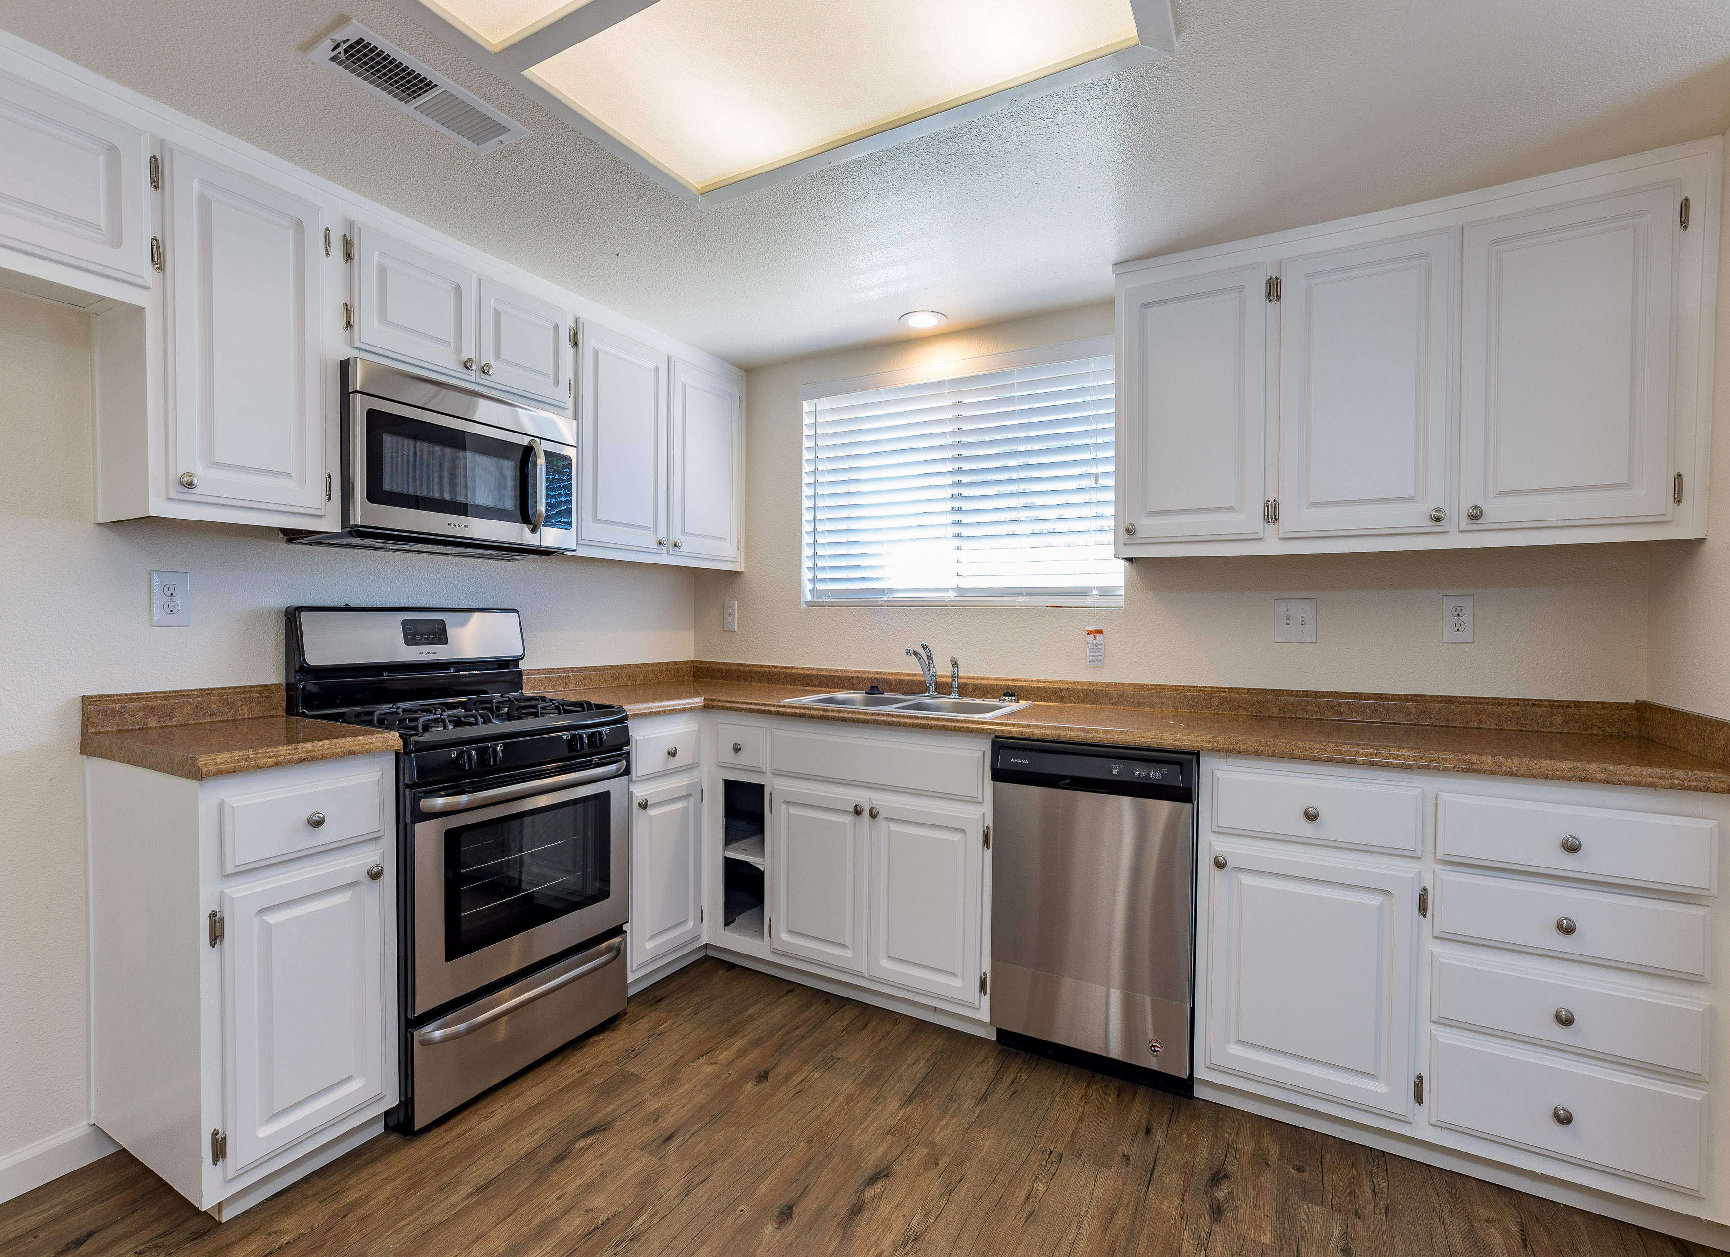
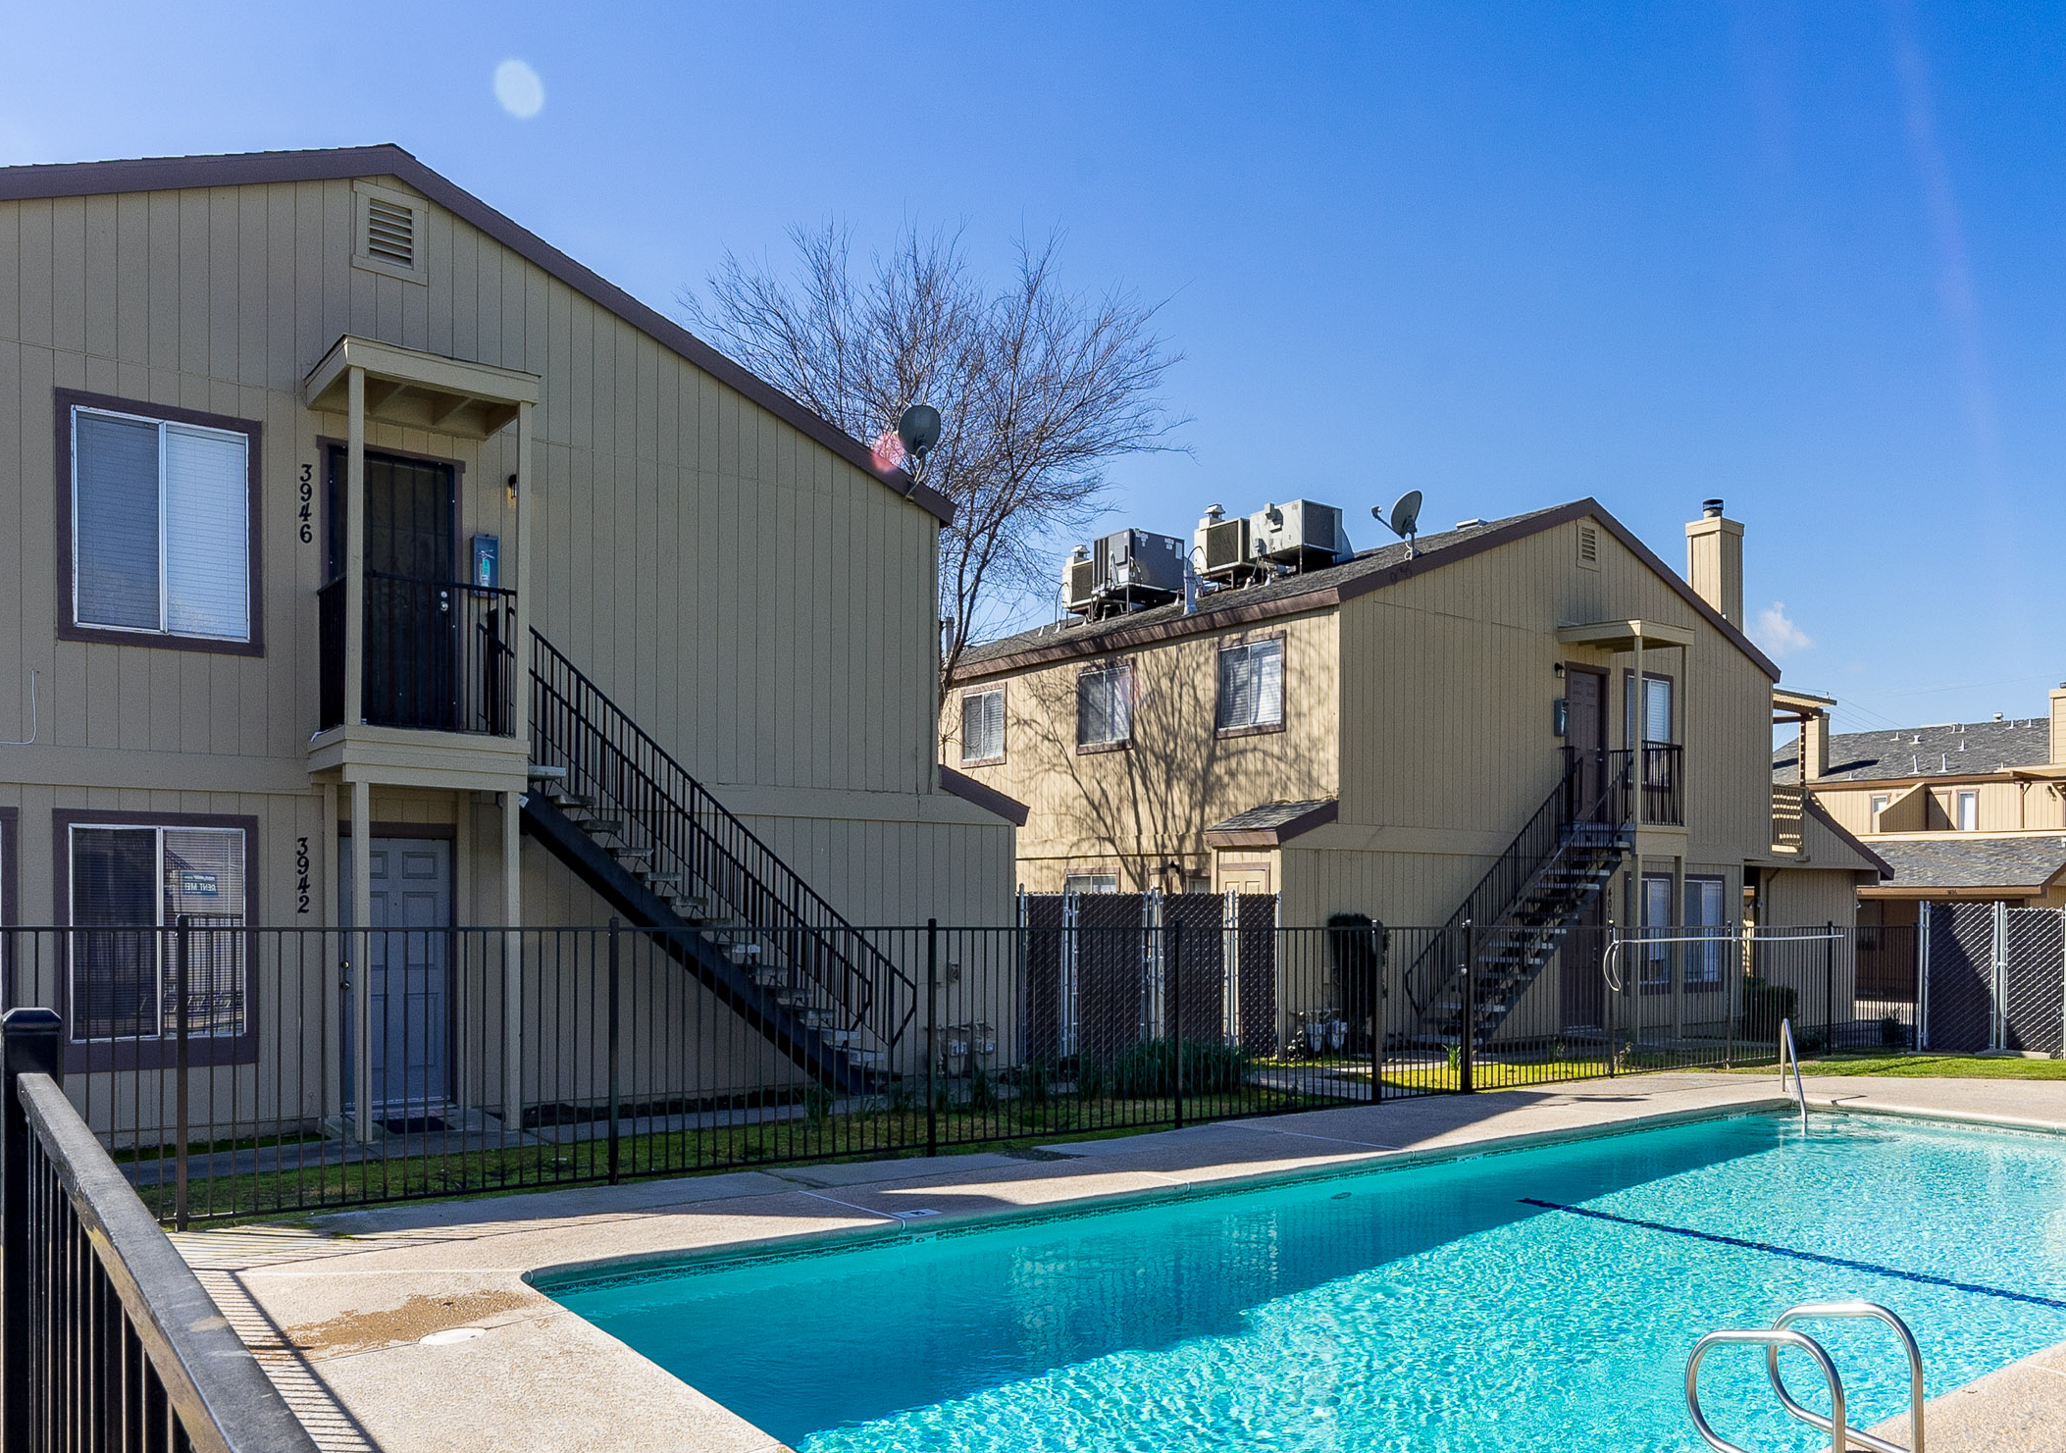
Commercial Real Estate Investment
Private Equity Offering, Phase II
$600,000
Closed and Over Subscribed
DEAL STORY & OPPORTUNITY
International Partners, LLC purchased this Apartment Community in 2003 consisting of 56 units all sized as 2 bedrooms & 1 bathroom.
The Class B Apartment Community is located in the California Central Valley and is valued at well over $7mm.
Since acquisition in 2003 the community has been professionally managed and essentially at full occupancy [95% - 100%].
A complete +$1mm renovation of the community was done between 2015 – 2020 and is now a “Best-in-Class” asset competitive with comparable apartments.
In 2020, we completed the 1st of a two phase equity recapitalization of about $2mm. The 2nd and final phase is being made available by the redemption or sale of $0.6mm equity by a couple of new partners.
With a completely renovated asset and no major capital expenditures for the upcoming 5 year investment period, the asset will generate exceptionally strong cash flow with moderate to strong appreciation in value. Accordingly, these factors provide a uniquely great opportunity for new investors to ride the next wave of increased cash flow and growth in value.
The Phase II $0.6mm buy-in will represent about 20% of the equity.
The investment holding period is 5 years to coincide with the next capital event and option to exit if so desired.
VALUE PROPOSITION
INVESTMENT AMOUNT BUY-IN
RETURNS Based on 5 Year Average
Cash on Cash
Equity Multiple
Internal Rate of Return
COVID-19, Vaccine Era CONSERVATIVE
10.2%
2.85x
25.95%
COVID-19, Vaccine Era OPTIMISTIC
10.8%
3.25x
29.49%
$135,000 Minimum
$600,000 Maximum
TIMELINE
KEY EVENTS Offering Open & Letter of Interest Period
Due Diligence Period of Evaluation
Decide to Proceed [Deposit Non-Refundable] Buy-in Funds to Escrow or Trust Account Closing
Cash Flow Distribution Starts
KEY DATES: 2021 May 1 – June 20
June 1 – 20
June 1 – 20
June 21 – 25
July 1, 2021
October 2021
FOR MORE INFO Visit: www.ipllcinvestments.com/featured-offering/ or www.ipllcinvestments.com/
© 2021 International Partners, LLC All rights reserved.

